Slide 4
Capacity to endure and continue

Slide 5
PEOPLE
Education
Education Excellence
Community
Civic engagement
Public involvement in sustainable community planning
Political support
Children
Adoption, foster care
Health and Safety
Personal Health
Community Health
Public Safety

Slide 6
PROFIT
Economic Development
Clean technologies Green jobs
Local Commerce Tourism
Local food Participation

Slide 7
PLANET
Natural Systems
Ecosystems Habitat
Water / Storm water Air quality
Waste Resource Conservation
Planning and Design
Land use Transportation
Parks and recreation
Energy
Energy conservation Green building
Renewable energy

Slide 8
PEOPLE

Slide 9
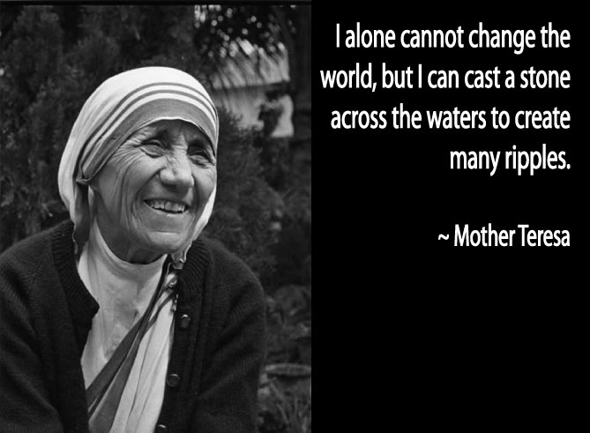

Slide 12
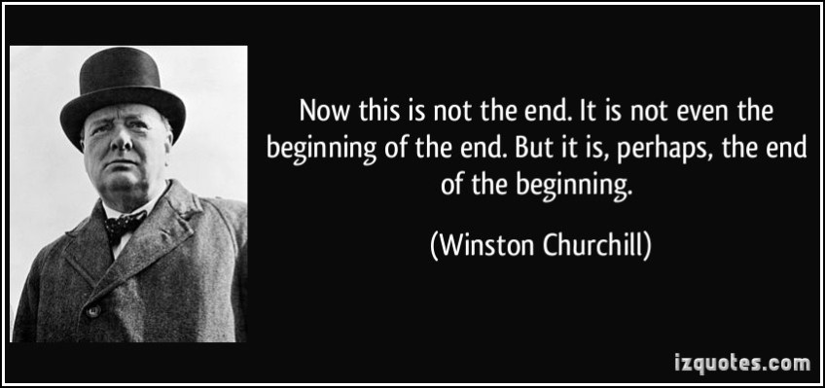

Slide 14
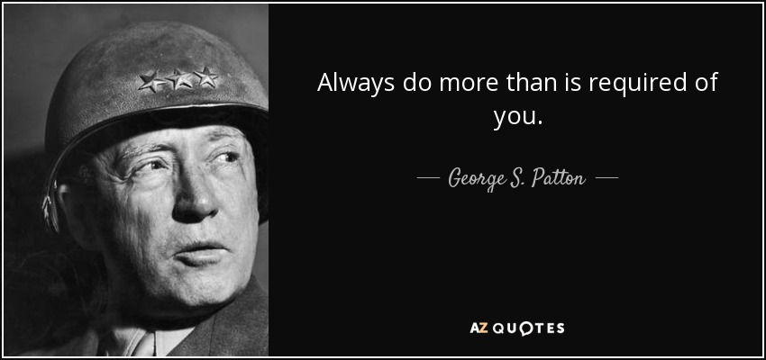

Slide 18
Capacity to endure and continue

Slide 19
https://www.youtube.com/watch?v=0GXFkKtMFWY

Slide 21
https://www.youtube.com/watch?v=hbkZrOU1Zag

Slide 24
Improved processes
Eliminate waste
Supportive culture
Open and receptive to new ideas
Team effort
Improve deliverables to clients / customers

Slide 25
PLANET

Slide 26
http://sfglobe.com/2015/04/15/truly-magnificent-aerial-footage-of-oahus-north-shore/?src=fbfan_39848

Slide 27
SUSTAINABILITY & OSU in Tulsa
Embrace sustainability through
instruction, research,
outreach, and operations.

Slide 28
Energy Conservation Program
Recycling
Housekeeping
Construction / Remodeling
Lawn care
Value culture of conservation
Acknowledge and celebrate good stewardship of resources

Slide 36
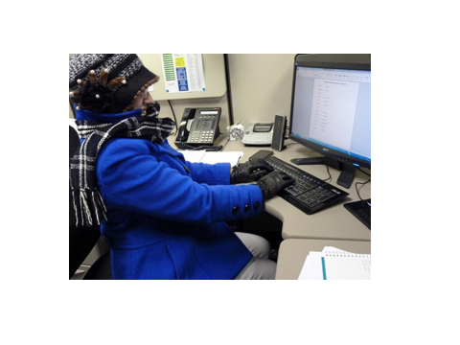

Slide 39
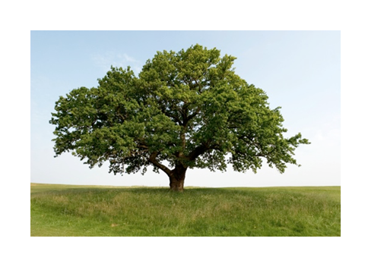

Slide 42
https://www.youtube.com/watch?v=a_urxI9L5Ak

Slide 44
GO POKES!!!

